Slide 1
The Tables and Matrices
The Tables and Matrices

Slide 2
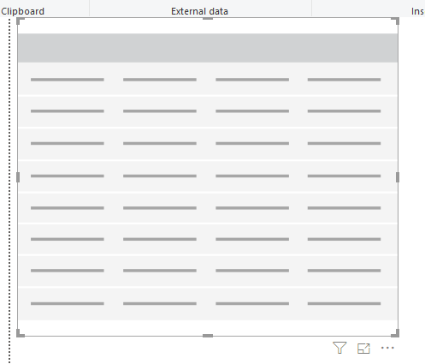
The Tables and Matrices
Add a Table visualization to the scene

Slide 3
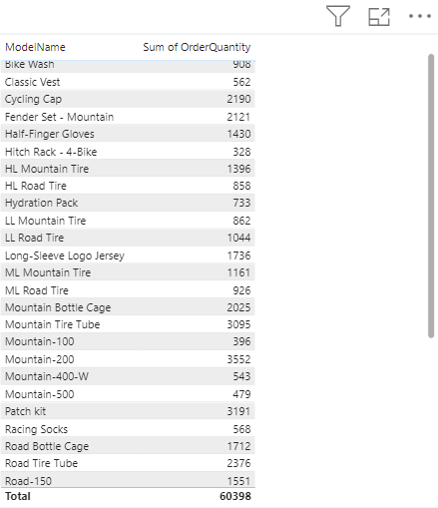
The Tables and Matrices
Add both fields ModelName from DimProduct and OrderQuantity from FactInternetSales and observe the values represented at table level
Click the small rectangle located at the level of each column header to change the sort order

Slide 4
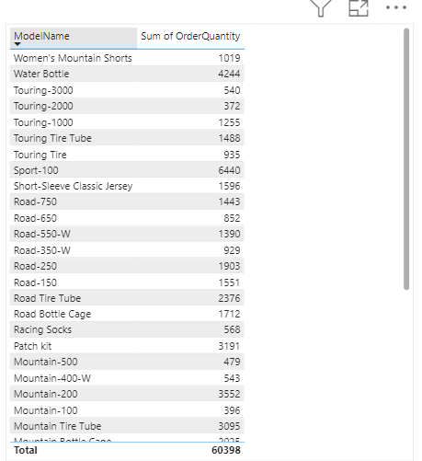
The Tables and Matrices
Click the small rectangle located at the level of each column header to change the sort order

Slide 5
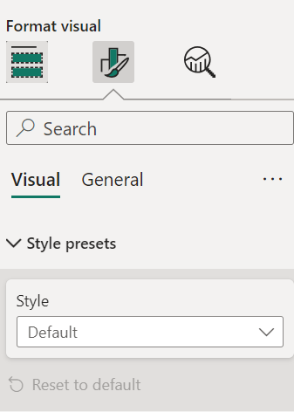
The Tables and Matrices
In the Format section change the Style setting to Bold Header

Slide 6
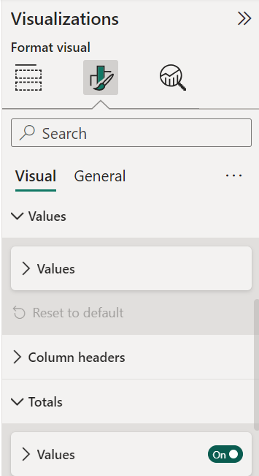
The Tables and Matrices
Still at the Format level try to activate/deactivate the value of the Totals parameter

Slide 7
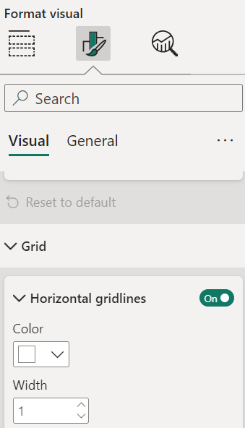
The Tables and Matrices
Try changing the value of the Grid parameter

Slide 8
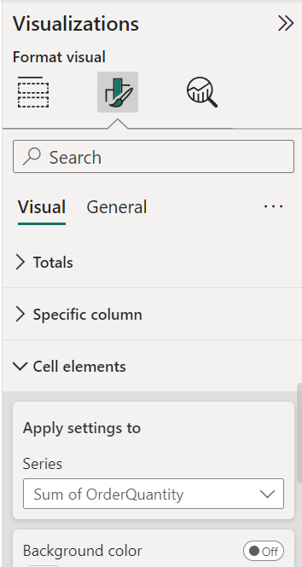
The Tables and Matrices
Always on Formatting section try to navigate to Cell elements section and select OrderQuantity
1
2
3

Slide 9
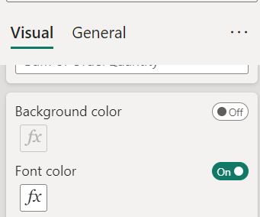
The Tables and Matrices
Activate FontColor

Slide 10
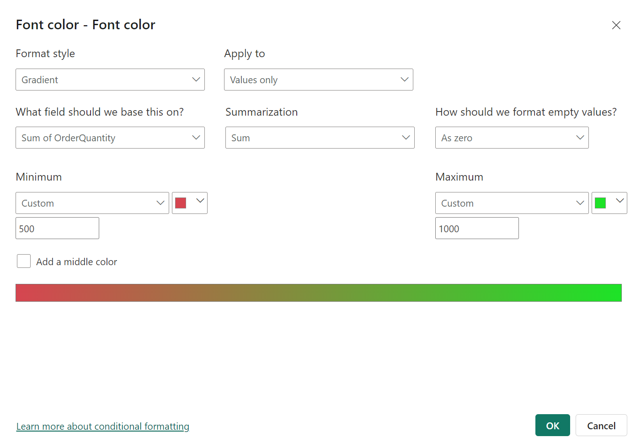
The Tables and Matrices
Then configure the conditional formatting based on SalesAmount values

Slide 11
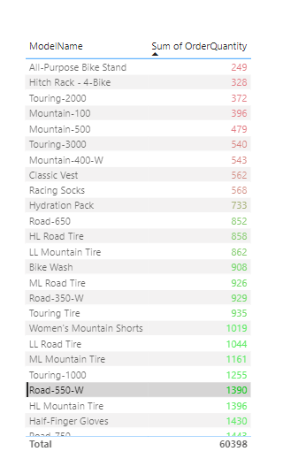
The Tables and Matrices
Observe the result

Slide 12
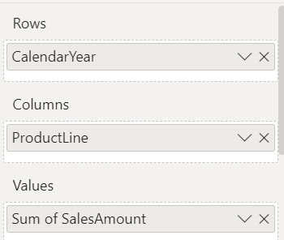
The Tables and Matrices
Table Visualization with Matrix Visualization
Configure it according to the table
Setting | Field
Rows | CalendarYear
Columns | ProductLine
Values | SalesAmount

Slide 13
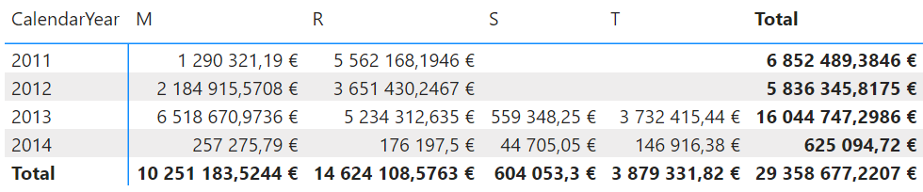
The Tables and Matrices
Observe the Matrix

Slide 14
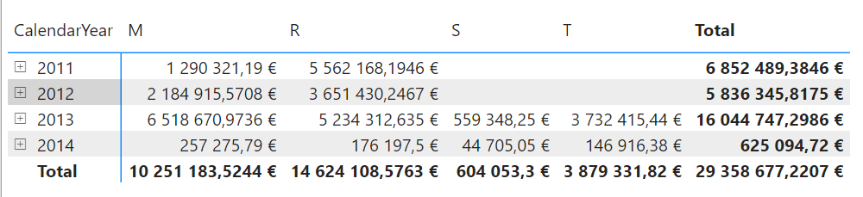
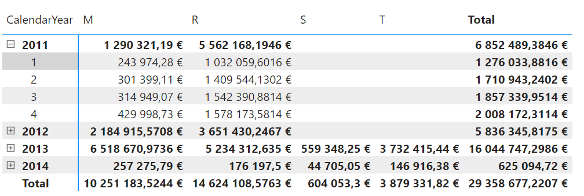
The Tables and Matrices
Add CalendarMonth at the rows level in addition to the CalendarYear and note the sign
Try to expand the view by clicking the sign

Slide 15
The Tables and Matrices
In the Format section try typing Subtotals , then try to enable/disable subtotals at the row and/ or column level

Slide 16
Thank you
Thank you

